Slide 1
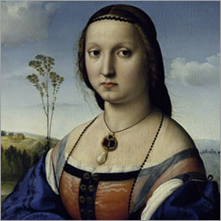
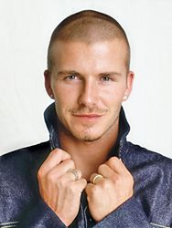
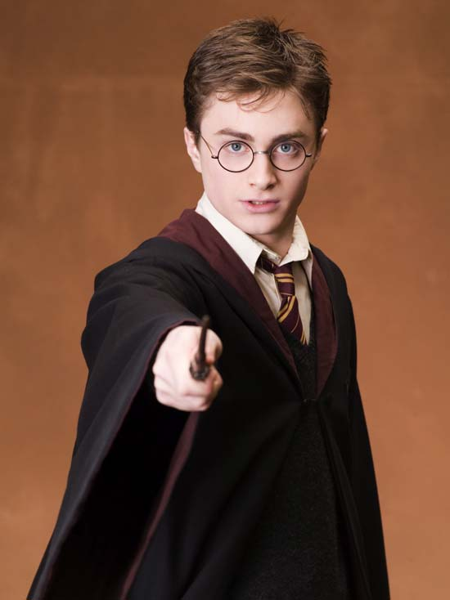
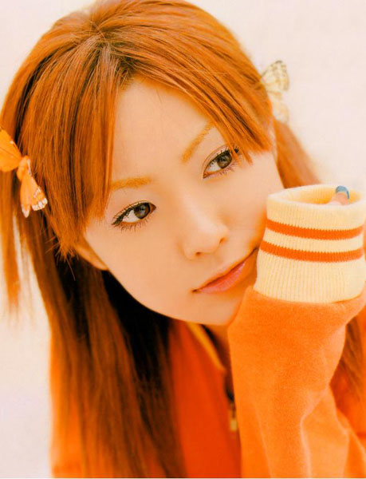
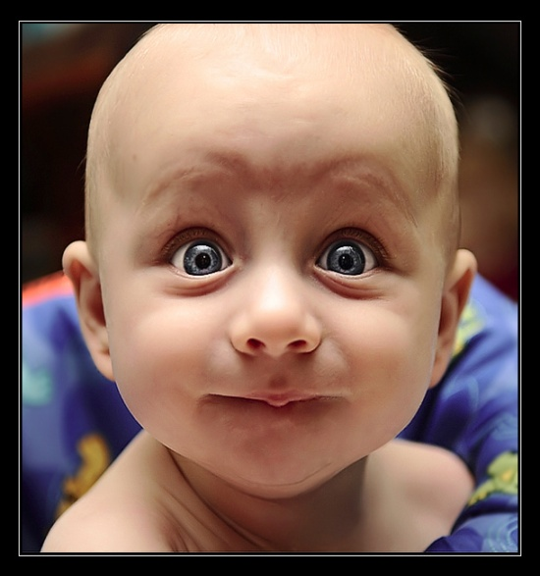
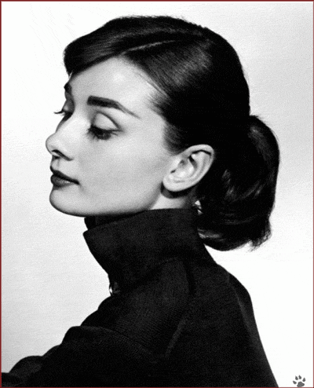
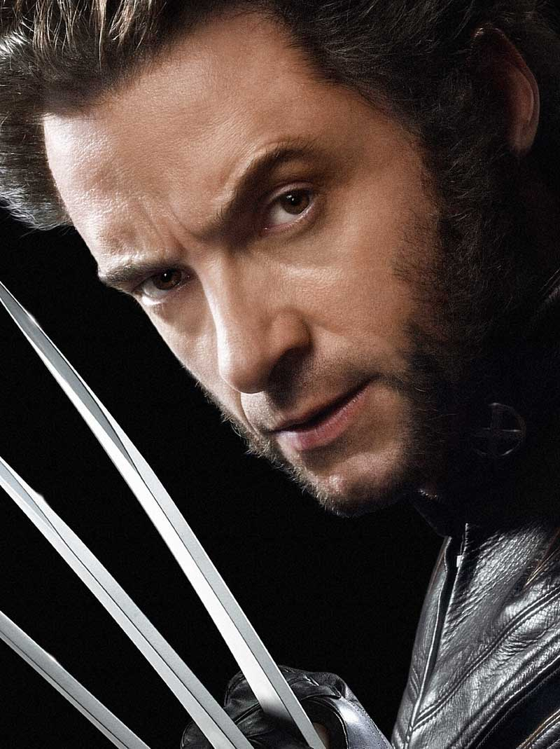
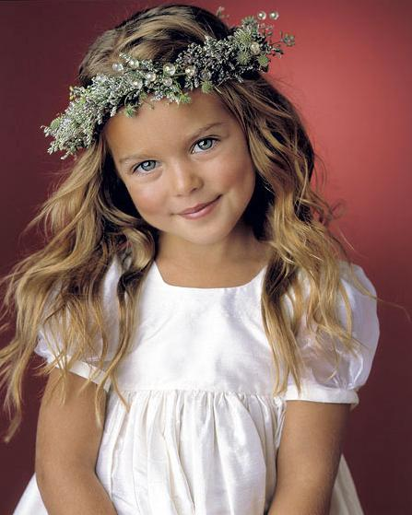
Appearance
Describing People
Notes:
1. Warm up.
Good morning, boys and girls!
Sit down, please!
I’m glad to see you again.
Get ready for the lesson.
Today we are going to talk about people’s appearance
and parts of the body.

Slide 2
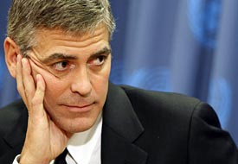
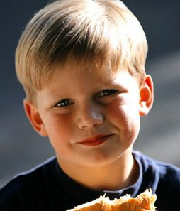
Age
He is old.
He is middle aged,
about forty.
He is young.
Notes:
Vocabulary Work 2
Now let’s speak about appearance.
To describe persons’ appearance correctly, first we go to the general characteristics: age, height, build.
Age
Is this man old or young?
How old is this man?
And what can we say about this boy age?

Slide 3
Height
He is tall.
He is short.
He is normal height.
Notes:
Height
- Is this man tall or short?
- And what about this man?
- What can we say about this man height?

Slide 4
Build
She is slim.
She is fat.
Notes:
Build
Is this girl slim or fat?
Is this girl slim or fat?

Slide 5
Hair
black hair
blonde/
fair hair
brown hair
grey hair
red hair
Notes:
Next we move to details such as hair and any other prominent features, like eyes, a nose, a mouth, a moustache, a beard and spectacles.
Hair
What colour is the hair?

Slide 6
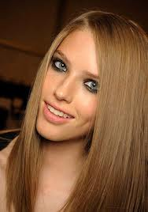
Hair
curly
wavy
straight

Slide 7
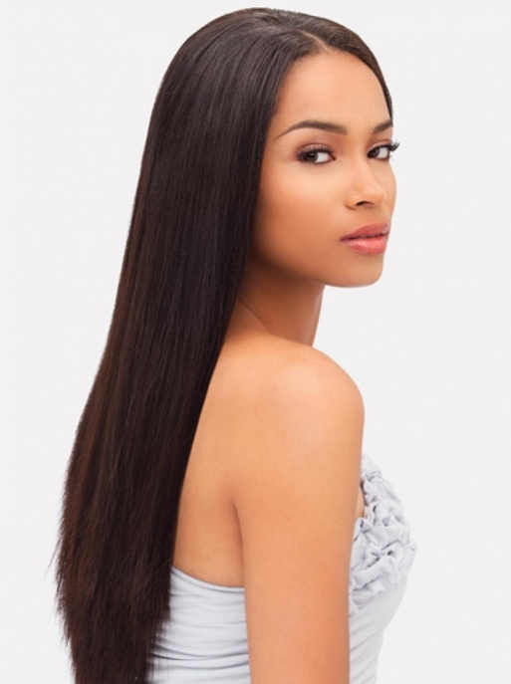
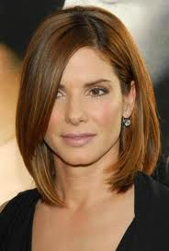
short
long
medium
length

Slide 8
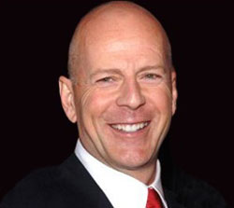
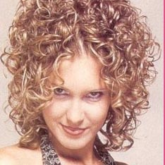
She has got
medium length,
curly and blonde hair.
He has no hair. =
He is bold.
or
Her hair is medium length,
curly and blonde.

Slide 9
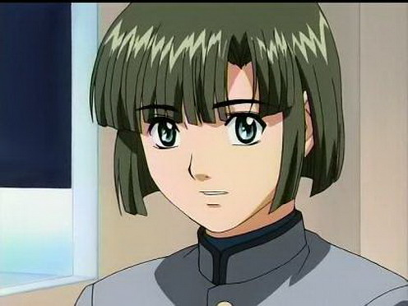
Type of hair
She has got…………
She has got…………………
or
or
Her hair is ………………….
Her hair is …………….
Notes:
Type of hair.
As you know hair can be straight or curly and short, long or medium length.
Have a look at the first picture. We can say: She has got long straight black hair. or Her hair is long straight and black hair.

Slide 10
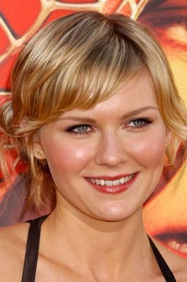
Face
Her face is oval.
or
She has got an oval face.
He face is round.
or
She has got a round face.
Notes:
Face
Is her face oval or round?
Is her face oval or round?

Slide 11
Eyes
grey eyes
blue eyes
green eyes
dark eyes
Notes:
Eyes
What colour are the eyes?
Note! This is a black eye!

Slide 12
Describe this boy
He`s got
eyes
hair.
His hair`s

Slide 13
Feel the difference.
What does he look like?
Как он выглядит?
Who does he look like?
На кого он похож?

